Slide 1
Python Project
Topic- flight fair prediction
Submitted By:
Janvi Sethi: 2210990431
Submitted to:
Tushar khitoliya

Slide 2
Table of Contents
Introduction
Problem Statement
Technical Details
Key Features
Project Highlights
Conclusion
References/Links used

Slide 3
Introduction
Utilizing Python, our flight fare prediction system employs advanced algorithms to forecast airfares accurately. By analyzing historical data, route popularity, seasonal trends, and other relevant factors, we aim to provide travelers with reliable estimates, empowering them to make informed decisions and secure the best deals for their journeys.

Slide 4
Problem Statement
Predicting flight fares accurately is crucial for travelers. This project aims to develop a Python-based solution for flight fare prediction. Leveraging machine learning algorithms and historical flight data, the system will forecast future ticket prices, empowering users to make informed decisions when booking flights.

Slide 5
Technical Details
Flight fare prediction in Python typically involves data collection, preprocessing, feature engineering, model selection (e.g., regression, random forest), and evaluation. Data may include factors like departure time, airline, destination, and season. Models are trained on historical data to predict future fares accurately. Common libraries include Pandas, Scikit-learn, and Matplotlib for visualization.

Slide 6
Key Features
Data Preprocessing: Clean and preprocess flight data including fares, dates, and routes.
Feature Engineering: Extract relevant features such as departure time, route popularity, and airline reputation.
Machine Learning Models: Implement regression algorithms like Random Forest or Gradient Boosting for prediction.
Cross-Validation: Validate model performance using techniques like k-fold cross-validation.
Deployment: Integrate the model into a Python application for real-time fare prediction

Slide 7
Project Highlights
Implemented flight fare prediction system in Python using machine learning techniques.
Utilized historical flight data and features like date, time, airline, etc., for accurate predictions.
Employed algorithms such as Random Forest or Gradient Boosting to train the model.
Achieved efficient prediction of flight fares, aiding travelers in planning and budgeting for their trips effectively.

Slide 8
Conclusion
In conclusion, utilizing Python for flight fare prediction offers a robust and efficient solution. By leveraging machine learning algorithms and historical data, accurate forecasts can be generated, aiding travelers in making informed decisions. This approach enhances user experience and facilitates cost-effective travel planning, contributing to a more streamlined and satisfactory booking process.

Slide 9
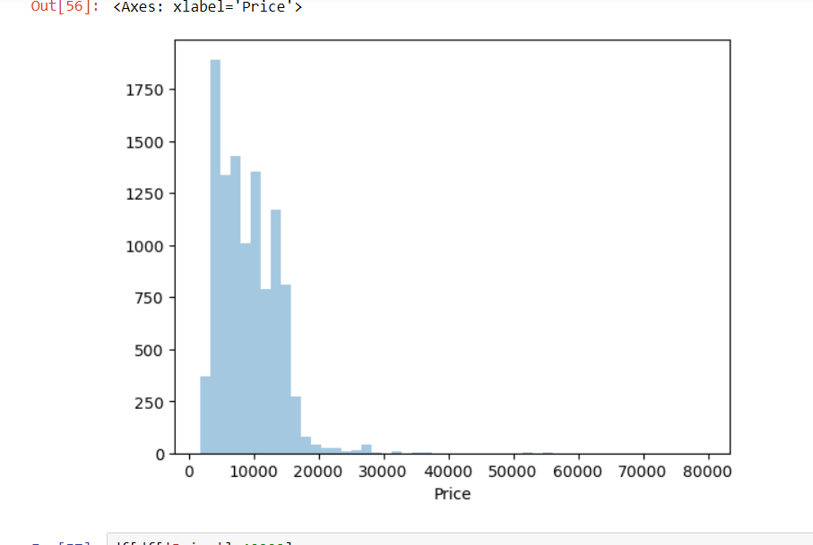
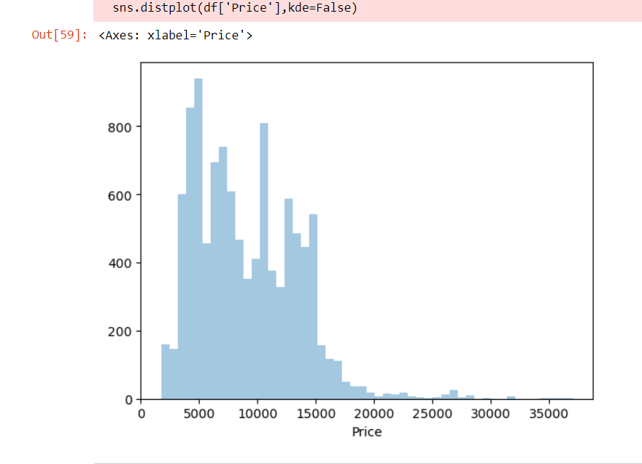
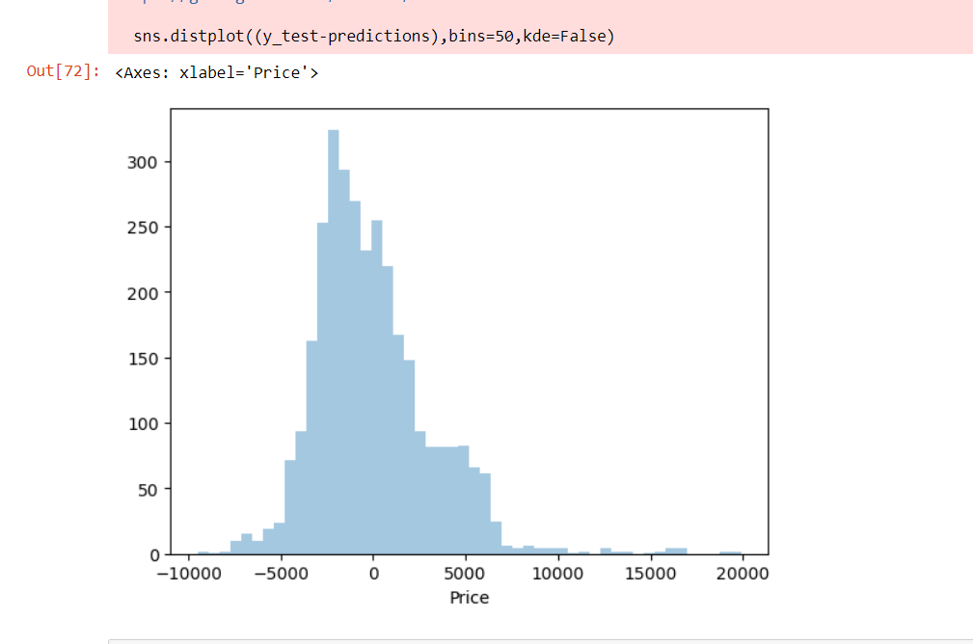
Layout

Slide 10
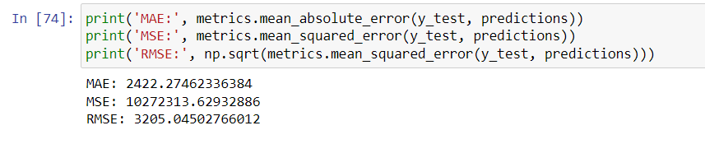
output

Slide 11
Output statement
1. Output contains a price above 35000 so it’s not a bad prediction
2. This model predicts values of the fare with an error of 2400 Rs.

Slide 12
References/Links used
W3Schools - https://www.w3schools.com/
Codecademy - https://www.codecademy.com/
Free code camp

Slide 13


